Slide 1

HackDelft 2019
Olivia, Ted, Tobias, Nathan

Slide 2

Idea
Trading stocks can be hard!
Let’s build an application to teach…
Principles of the stock market
The basics of trading algorithms
Variables that affect loss and gains
All without losing a cent!

Slide 3
My Little Trader Bot
Simple, reversion trading strategy
Customizable inputs on User Interface
Increase financial literacy
Educational tool

Slide 4


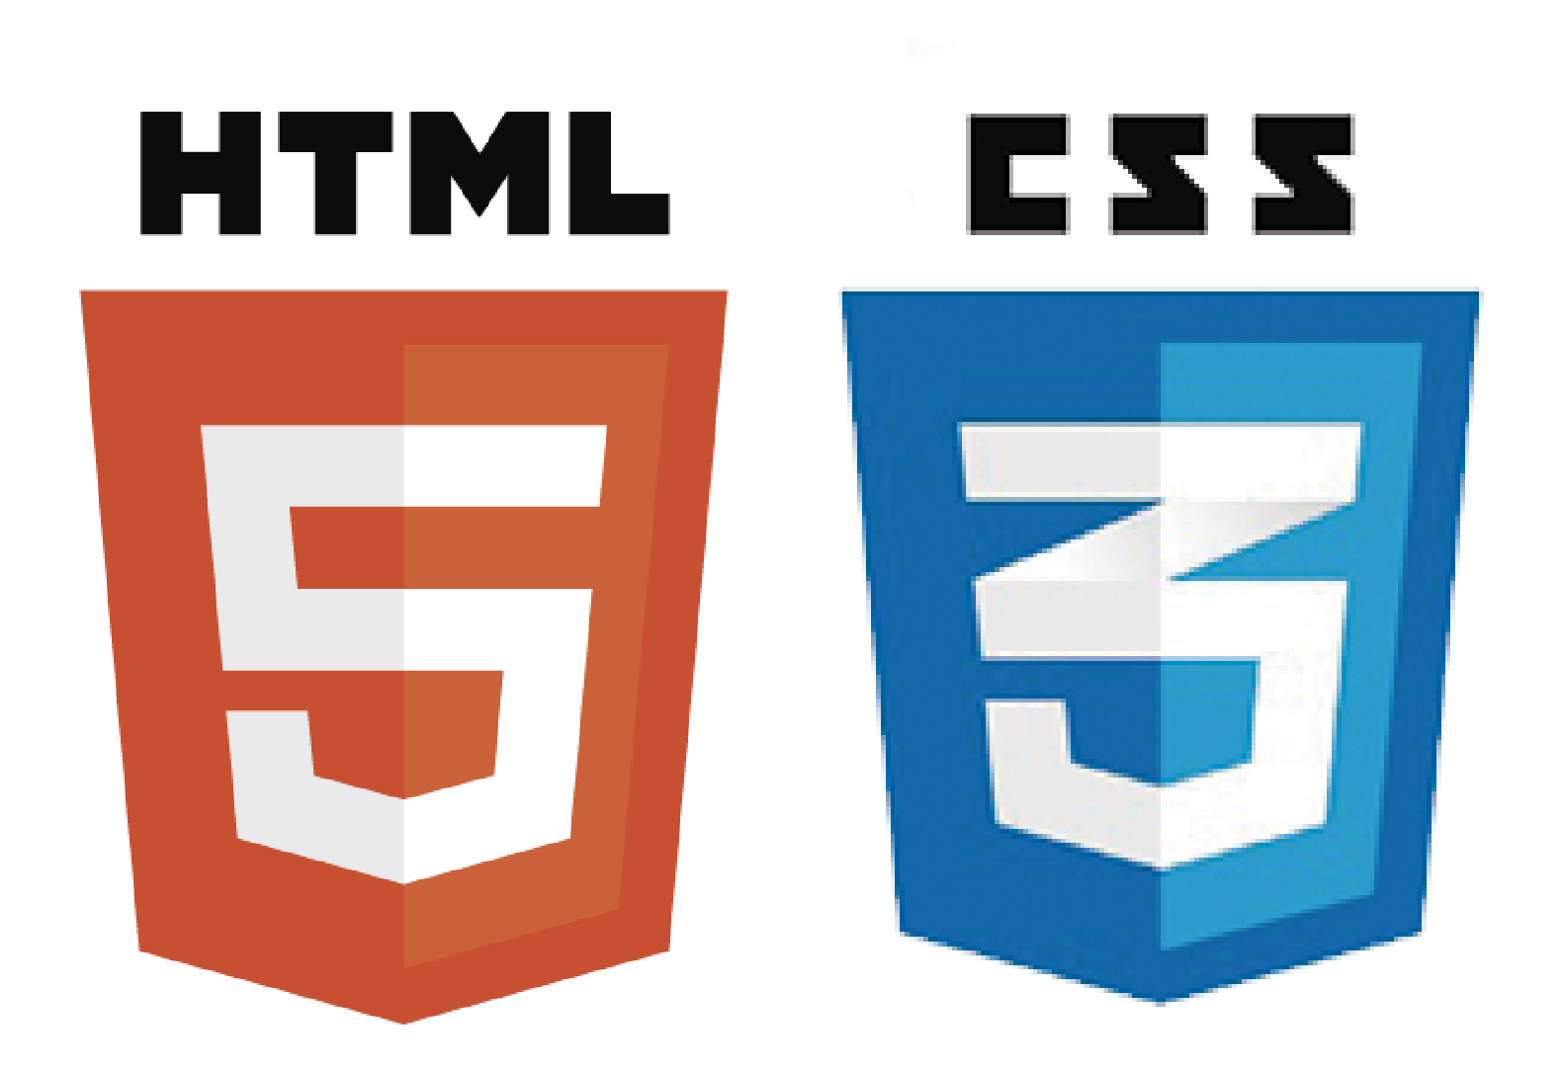


What’s Inside?

Slide 5
Challenges
Analyzing stock data
Determining relevant descriptive statistics
Integration between server and website
Understanding financial risk

Slide 6
Next step…
Drag and drop flowchart interface
Test your own algorithms
From Kindergarten to University levels

Slide 7
Accomplishments
Worked well as a team
Kept cool, relentless
Models developed in parallel
Can build upon it
Motivated to learn more

Slide 8
Questions?

